Slide 1
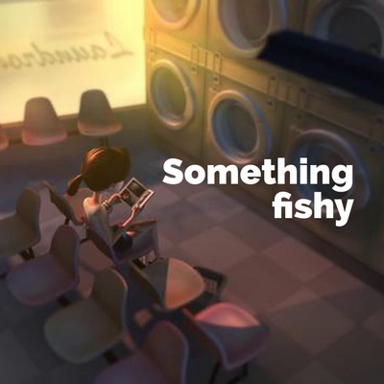
Prime area: Personal, Social and Emotional Development
Children will learn to:
show perseverance when faced with challenges
deal with emotions, making things right and how to make amends for previous actions
give focused attention to the speaker, responding appropriately even when engaged in an activity
show sensitivity to others
Reception Summer 2
Topics: What lives in the sea?
Summer
Key texts:
Specific area: Literacy
Children will be:
engaging in a range of fiction and fact books and identifying the difference
reading simple phrases and sentences made up of words with known letter–sound correspondences and, where necessary, a few exception words
forming most lower case and capital letters correctly
writing simple sentences using their phonic knowledge
writing for a purpose e.g. labelling pictures, writing captions, facts, stories and simple sentences
enjoying poetry including some with rhyme
Prime area: Communication and Language
Children will be:
learning to talk about, predict and change stories
imagining and recreating roles in real life situations
using tenses past, present and future
articulating their ideas and thoughts in well-formed sentences using some recently learnt vocabulary
learning to make up their own stories with actions
asking ‘How?’ and ‘Why?’ questions
telling their own stories
Characteristics of effective learning
Playing and exploring – engagement
Finding out and exploring
Playing with what they know
Being willing to ‘have a go’
Active learning – motivation
Being involved and concentrating
Keeping trying
Enjoying achieving what they set out to do
Creating and thinking critically – thinking
Having their own ideas
Making links
Choosing ways to do things
Specific area: Mathematics
Children will be learning:
to consolidate a deep understanding of the number 10
to automatically recall number bonds to 5 and beyond
comparing quantities up to10 in different contexts, recognizing greater than, less than and the same
Prime area: Physical Development
Children will learn to:
continue to develop their small motor skills so that they can use a range of tools competently, safely, and confidently
learn to represent movement through dance
combine different movements with ease and fluency
show accuracy and care in their letter formation and in their drawings
Specific area: Expressive Arts and Design
Children will be:
learning how to evaluate their work and make it better
creating something with a form and function
inventing and adapt stories with their peers
learning to represent their ideas through art and design
performing songs and poems to others
Specific area: Understanding the World
Children will be:
exploring and recording the seasonal changes in Summer
going on walks around the school to observe seasonal changes and the local environment, flora and fauna
investigating floating and sinking
learning about habitats in and around the sea
looking at maps and giving directions

