Slide 1
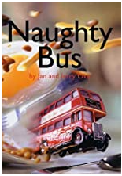
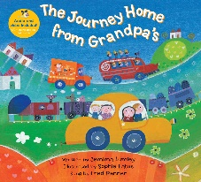
Specific area: Literacy
Children will learn:
to learn: print has meaning - the names of the different parts of a book
to recognise words which have the same initial sounds.
to spot and suggest rhymes.
count or clap syllables in a word.
write a pretend shopping list that starts at the top of the page; write ‘m’ for mummy.
to continuing with phase 1 phonics.
to write some letters in their name.
Prime area: Personal, Social, Health and Emotional
Children will learn:
to follow rules, understanding why they are important.
to talk about their feelings using words like ‘happy’, ‘sad’, ‘angry’ or ‘worried’. children will be working on becoming more assertive.
Nursery Spring 1
Topics: What is Hattersley Like?
Key texts:
Prime area: Communication and Language
Children will learn :
a wider range of vocabulary related to their community.
to ask questions to find out more about the world.
to start a conversation with an adult or a friend and continue to take turns.
to express a point of view and to debate when they disagree with an adult or a friend, using words as well as actions
Specific area: Mathematics
Children will learn:
to link numerals and amounts: for example, showing the right number of objects to match the numeral, up to 5 and beyond.
combine shapes to make new ones like an arch or a bigger triangle.
talk about and explore 2d and 3d shapes (for example, circles, rectangles, triangles and cuboids) using informal and mathematical language: ‘sides’, ‘corners’; ‘straight’, ‘flat’, ‘round’.
Characteristics of effective learning
Playing and Exploring – engagement
Finding out and exploring
Playing with what they know
Being willing to ‘have a go’
Active learning – motivation
Being involved and concentrating
Keep trying
Enjoying achieving what they set out to do
Creating and thinking critically – thinking
Having their own ideas
Making links
Choosing ways to do things
Prime area: Physical development
Children will learn:
to use and remember sequences and patterns of movements which are related to music and rhythm.
to hold a pencil correctly (tri pod grip).
to hold the scissors correctly and make snips in the paper.
to to develop movement, hopping skipping and stand on one leg.
Specific area: Expressive Arts and Design
Children will learn:
to play instruments with increasing control to express their feelings and ideas.
remember and sing entire songs.
to re tell and make up stories using the small world props.
explore different materials freely, in order to develop their ideas about how to use them and what to make.
Specific area: Understanding the World
Children will learn :
about their local area and draw maps and talk about their surroundings.
begin to make sense of their own life-story and family’s history.
show interest in different occupations.

